Slide 1
PHYS 1050 Tutorial 2
Yutong Zhao
Department of Physics and astronomy
University of Manitoba
Feb 7th 2019

Slide 2
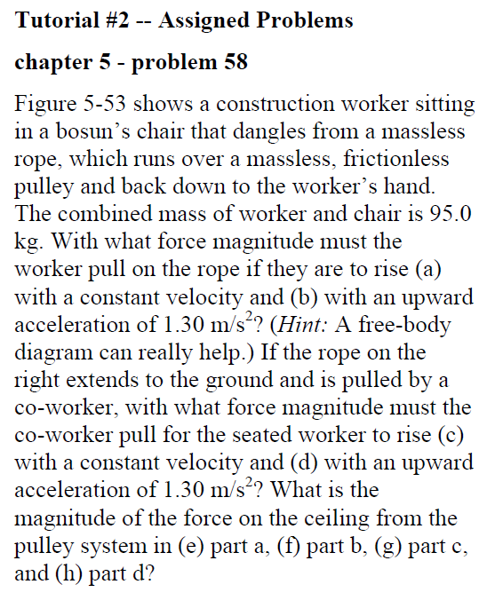
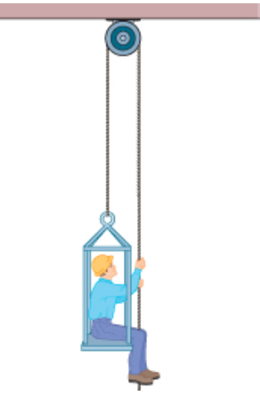
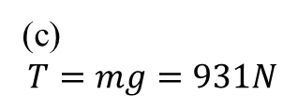
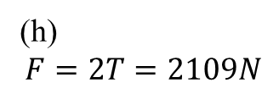
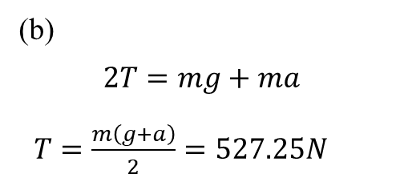
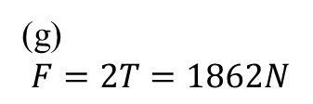
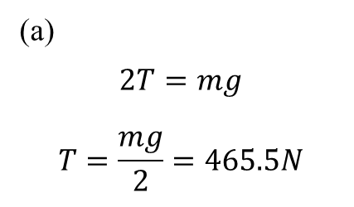
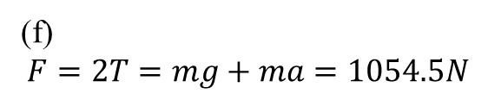

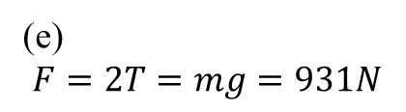
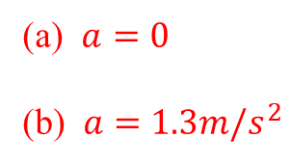
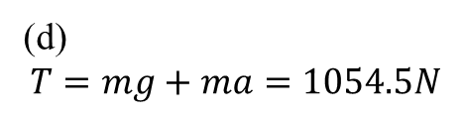
(a)
$$2T=mg$$
$$T=\frac{mg}{2}=465.5N$$
(a) $a=0$
(b) $a=1.3m/s^{2}$
(b)
$$2T=mg+ma$$
$T=\frac{m\left(g+a\right)}{2}=527.25N$
$$T$$
(c)
$$T=mg=931N$$
95kg
(d)
$$T=mg+ma=1054.5N$$
(e)
$$F=2T=mg=931N$$
(g)
$$F=2T=1862N$$
(f)
$$F=2T=mg+ma=1054.5N$$
(h)
$$F=2T=2109N$$

Slide 3
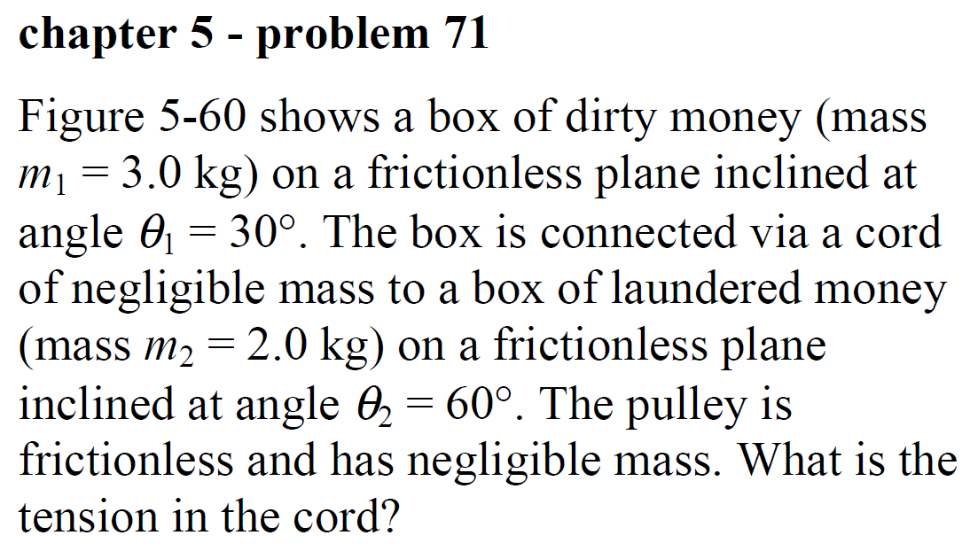
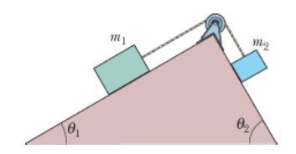
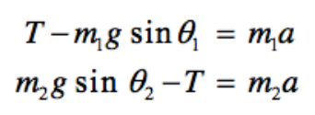
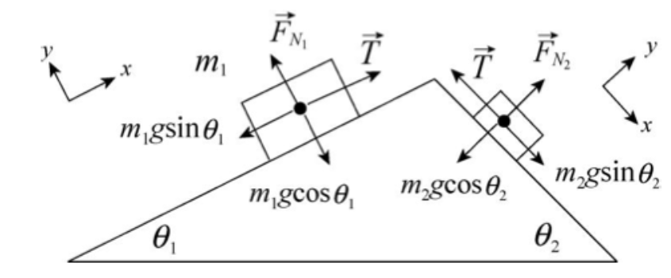
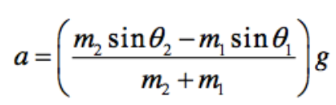
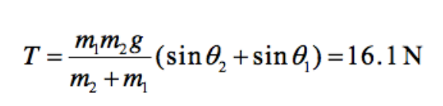

Slide 4
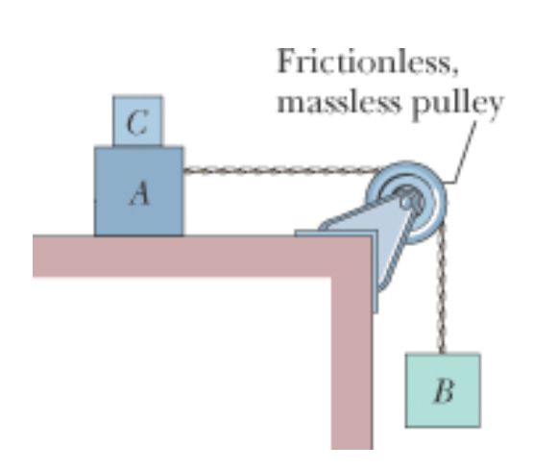
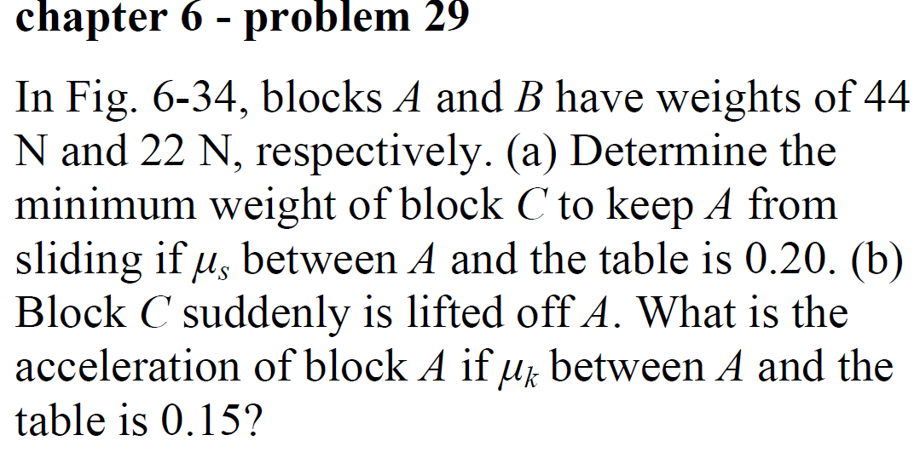

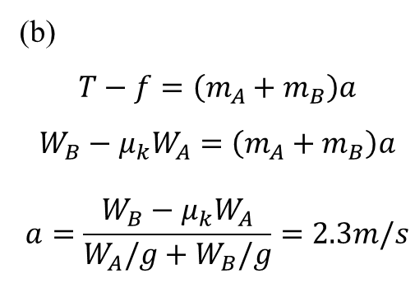
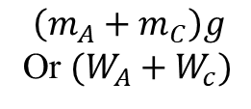
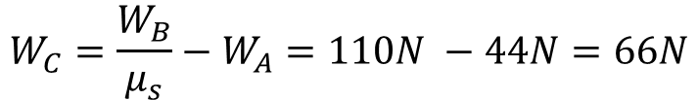
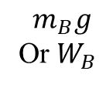
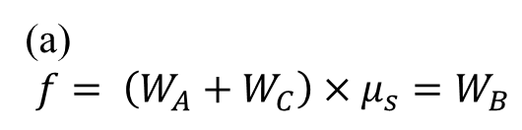



$$F_{N}$$
$$f$$
$$T$$
$$T$$
$$\left(m_{A}+m_{C}\right)g$$
Or $(W_{A}+W_{c})$
(a)
$$f= \left(W_{A}+W_{C}\right)×μ_{s}=W_{B}$$
$$W_{C}=\frac{W_{B}}{μ_{s}}−W_{A}=110N −44N=66N$$
(b)
$$T−f=\left(m_{A}+m_{B}\right)a$$
$$W_{B}−μ_{k}W_{A}=\left(m_{A}+m_{B}\right)a$$
$$a=\frac{W_{B}−μ_{k}W_{A}}{W_{A}/g+W_{B}/g}=2.3m/s$$
$$m_{B}g$$
Or $W_{B}$

Slide 5
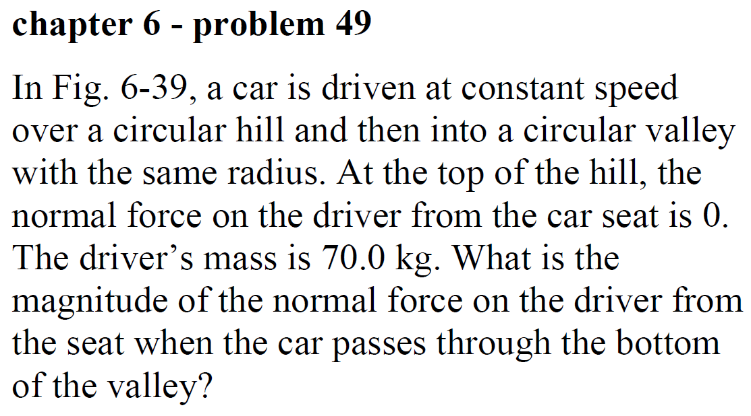
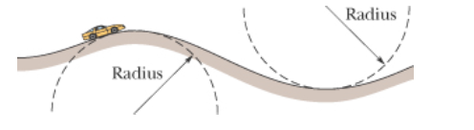
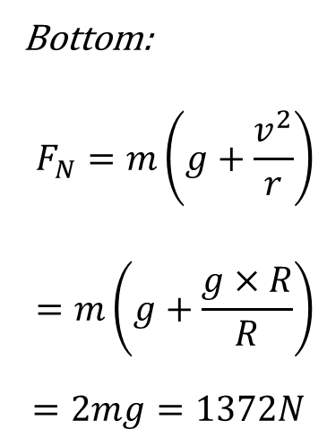
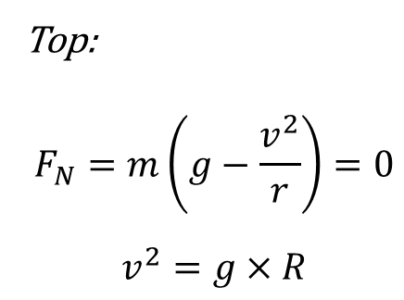
Top:
$$F_{N}=m\left(g−\frac{v^{2}}{r}\right)=0$$
$$v^{2}=g×R$$
Bottom:
$$F_{N}=m\left(g+\frac{v^{2}}{r}\right)$$
$$=m\left(g+\frac{g×R}{R}\right)$$
$=2mg=1372N$

